Slide 1
French I
Mademoiselle Fryer
Room 407

Slide 2
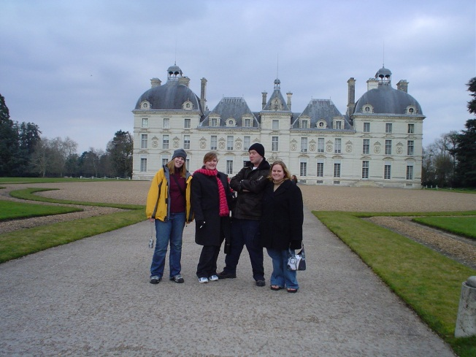
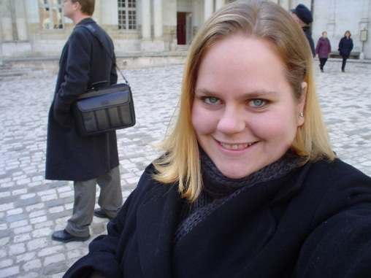
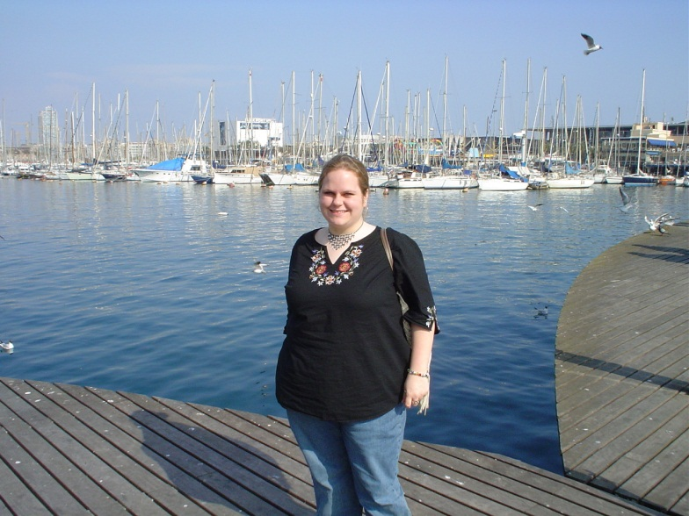
Who is Mademoiselle Fryer?
Graduated #11 from Clinton in 2002.
Studied abroad in Cannes, France and Pontlevoy, France.
Graduated from USM in 2006 with a Bachelor of Arts in French Language and Culture.

Slide 3
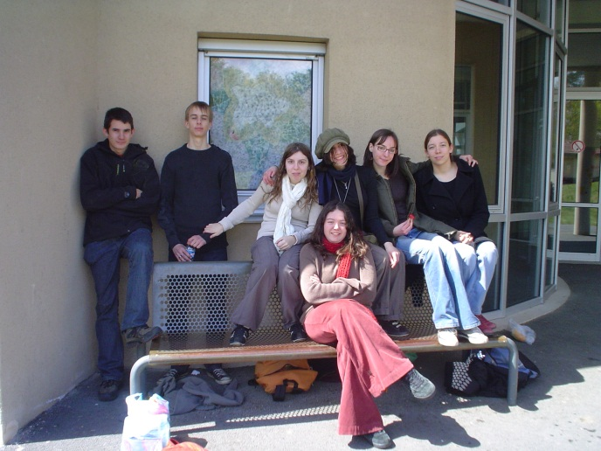
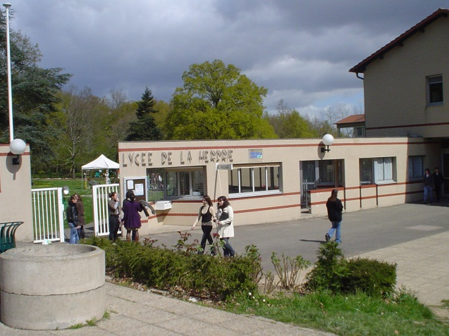
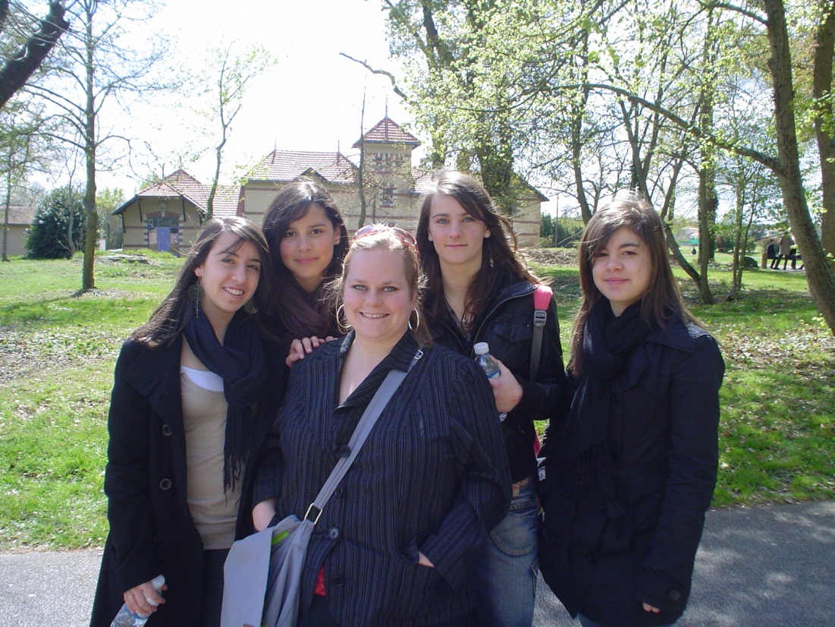
Who is Mademoiselle Fryer?
Taught English near Nantes, France in 2007-2008.
This is my 4th year teaching French I at Forest Hill.

Slide 4
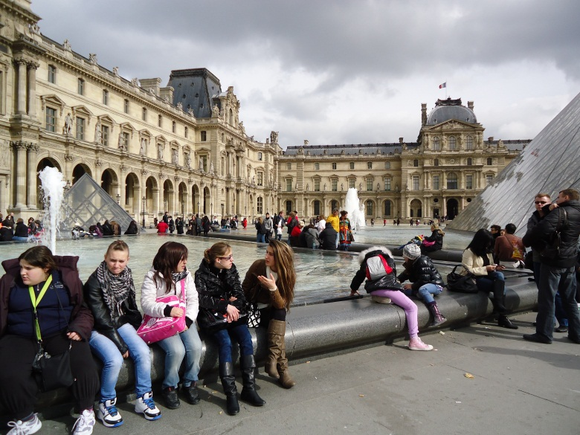
Who is Mademoiselle Fryer?
I love reading, travelling, cooking, eating, drinking coffee, drawing, writing, singing, and talking to new people.
My favorite animals are cats, but I love dogs too.
Last year, I went with the Journalism class to Paris, Florence and Rome.

Slide 5
School supplies
What you will need to succeed:

Slide 6
3”x5” Index cards
Ruled
3X5 inches
White
One pack of 100 cards

Slide 7
Highlighters
5 colors
Bic Briteliner Highlighters only

Slide 8
Index Card Box
Any color
3 x 5 size

Slide 9
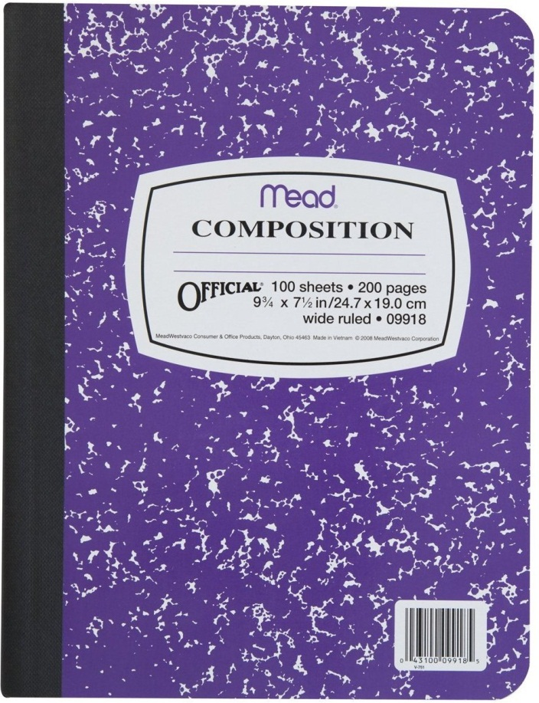
2 Composition Books
Any color
Must be hard cover with sewn spine.
Label with your name and French I.

Slide 10
22 x28 inch poster board
Any color
Label with your name and class block

Slide 11
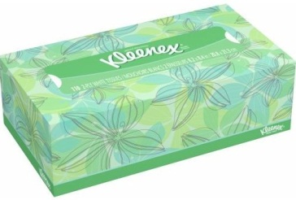
Kleenex
1 box regular tissues

Slide 12
Hand Sanitizer
Germ-X Hand Sanitizer, Aloe 8 fl oz

Slide 13
The rules
What you will need to succeed

Slide 14
Rule 1
Do NOT get up or talk without permission.

Slide 15
Rule 2
No food, gum or electronics.

Slide 16
Rule 3
Follow the dress code.

Slide 17
Rule 4
Respect yourself and others: no profanity or bullying.

Slide 18
Rule 5
Be on time, in your seat, with all materials needed, ready to work EVERY DAY.

Slide 19
consequences
What you need to succeed:

Slide 20
Tardy Policy
Each tardy will result in a ZERO for the Bellringer assignment, plus the following consequences:
1st offense: 25 lines
2nd offense: 50 lines
3rd offense: 100 lines plus parent phone call
4th offense: office referral

Slide 21
Consequences for Breaking a Rule
1st offense: Warning
2nd offense: Writing assignment
3rd offense: Doubled writing assignment, and parent phone call
4th offense: Office referral
Insubordination (refusing a consequence) and fighting, either verbal or physical, will result in IMMEDIATE office referral.

Slide 22
Consequences for Dress Code Violations
Those wearing their clothes improperly will not be allowed in class.
Those wearing inappropriate clothes will be sent to the office to call for a change of clothes.
Those whose clothes return to their out-of-dress-code status during class will receive these consequences:
1st Offense: Warning and direction to correct the issue (fix clothes).
2nd Offense: Clothes Fixed and Writing assignment given.
3rd Offense: Parent phone call and office referral.

Slide 23
Seating Arrangements
You will have an assigned seat in this class all year long.
I will change seating arrangements as necessary.
You MUST sit in your assigned seat, unless directed to do otherwise.
If you have a legitimate reason that you need to be moved (can’t see the board, issues with a neighbor) see me after class to discuss it with me. Do NOT take it upon yourself to move.

Slide 24
Procedures
What you will need to succeed:

Slide 25
Assembly Procedures
From time to time, we may have to go to the auditorium as a class.
Anytime we leave the room as a group, you must follow these procedures.
Line up as a class. You will walk in a SINGLE-FILE line, against the wall.
Be SILENT in the hallway.
Do NOT talk to, touch (shake hands, high five, push, shove), or otherwise interact with anyone in the hallways.
Stay together as a class.
Be respectful, and follow all other instructions.

Slide 26
Lunch Rules/Procedures
Walk in a SINGLE-FILE LINE on the right hand wall.
Do NOT talk to, touch, or laugh at anyone in the hallway.
Do NOT interact with people in other classes.
Stay together, leave no gaps in the line.
Be POLITE to staff: please and thank you, yes or no ma’am/sir.
Keep your place in line: if you cut, or break a rule, you will go to the end of the line.

Slide 27
Entrance Procedure
Greet your teacher, and any student greeters, by saying, “Bonjour!”
Take an index card.
Sit down immediately and stay quiet.
Start working on Bellringer immediately.
Name
Date
Class Block
Bellringer Number
BR # 1.2
1.
2.
3.
4.
Label Bellringers Like this!

Slide 28
Exit Procedures
Complete all assignments and give activity books to activity book collector to put away.
Clean up your area.
Return all materials to their place.
Close your book and place on the top, right-hand corner on your desk.
Sit QUIETLY and wait to be dismissed. Signal: Teacher will say “Merci, au revoir!”
REMEMBER: The bell does not dismiss you, I dismiss you.

Slide 29
Getting Help
You have a yellow card in the pencil pouch on the back of your desk.
While we are working independently, raise your hand silently to get my help and keep working!
If I have not come to your desk after 1 minute, lower your hand and place the yellow card on top of your seat number.
Keep working while you wait for my help.

Slide 30
If you are absent:
When you return, check the assignment board.
This will tell you what notes, activities, and bellringers you missed.
It is YOUR responsibility to make up these assignments and notes. You may ask to use my notebook and activity books to check your work.
You will need to look at the lesson plans by the door to see what the bellringer was.

Slide 31
The work
What you will need to succeed

Slide 32
Notes
Each day, you will take notes in this class.
You will have two types of notes: Vocabulary, and Structure.
You will need to study a minimum of 10 minutes every day (even the days you don’t see me)
Your notes must be written in one of your two composition notebooks.
You must bring this notebook to class daily.
You CANNOT succeed without studying in this class.

Slide 33
Notes: Vocabulary
Un ami
Une amie
Un garçon
Une fille
Brun
Brune
Amusant
Amusante
Grand
Grande
A male friend
A female friend
A boy
A girl
Brunette (for a boy)
Brunette (for a girl)
Funny (for a boy)
Funny (for a girl)
Tall (for a boy)
Tall (for a girl)

Slide 34
Notes: Vocabulary
When you take notes on vocabulary, you will need to color-code them in class.
All feminine nouns, and feminine forms of adjectives will be highlighted in PINK.
All masculine nouns, and masculine forms of adjectives will be highlighted in BLUE.
Adjectives that do not change will be highlighted in PURPLE (or PINK and BLUE).
REGULAR VERBS will be highlighted in GREEN.
IRREGULAR VERBS will be highlighted in YELLOW.
You will not highlight adverbs or prepositions.

Slide 35
Notes: Structure or Grammar
In each Chapter, there will be charts explaining a particular point of grammar on which you will be tested at the end of the chapter.
You will need to copy the charts and any explanations into your notes.
We will do several activities using each new concept, and by the end of the chapter, you will be expected to APPLY the concept on the chart. This is easiest to do if you have MEMORIZED the chart.

Slide 36
Activities
Your other composition notebook will be referred to as your “activity book.”
You will leave this notebook here in the room. The Activity Book Distributor will pass out the activity books daily.
Any work that we do in class will go into this book.
Each activity must be labeled with the CHAPTER number, the ACTIVITY number, and the PAGE number.
Skip a line between activities.
If you miss a day of school, it is YOUR responsibility to look at the assignment board, and make up any activities that you have missed.

Slide 37
Activities
You will receive an Assignment Grade for ALL of the activities in each Chapter. You will receive a separate grade for the “Assessment” at the end of each chapter, and a participation grade for any oral activities in each chapter.
You will also receive an assignment grade for the homework packet you will have for each chapter.
All of these Assignment Grades together will count for 30% of your overall grade.

Slide 38
Bellringers
Each day when you come in, you will be handed a 3”x5” ruled index card.
There will be a short assignment on the Promethean board for you to complete on this card.
The blank side must be labeled with:
Your Name
Your Class Block
Today’s Date
Bellringer Number
You will receive a grade for all the Bellringers in each chapter.
The Bellringer Grades will count for 10% of your overall grade.

Slide 39
Tests
You will be tested at the end of each chapter.
These tests will assess how well you know the vocabulary and structure from that particular chapter.
Once per term, you will have a comprehensive exam of everything you have learned up until that point.
Each of the chapter tests will consist of Multiple Choice, Fill-in-the-Blank, True/False, Matching, and Short Essay questions.
Your tests will count as 60% of your overall grade.

Slide 40
Projects
Throughout the year, I will assign projects based on the theme of the chapter we are studying.
All projects will count as test grades, and will be graded accordingly.
Due dates for projects are FINAL. No late projects will be accepted.

Slide 41
Grading

Slide 42
Final Grades
Term 1 | Term 2 | Semester Exam | Semester 1 Average (S1) | Term 3 | Term 4 | Final Exam | Semester 2 Average (S2) | Final Average
45% + | 45% + | 10% = | 100% | 45% + | 45% + | 10%= | 100% | (S1+S2)/2= Final Average
Term 1 | Term 2 | Semester Exam | Semester 1 Average (S1) | Term 3 | Term 4 | Final Exam | Semester 2 Average (S2) | Final Average
60 x 0.45= 27 + | 60 x 0.45= 27 + | 60 x 0.10= 6= | 60 | 60 x 0.45= 27 + | 60 x 0.45= 27 + | 60 x 0.10= 6 | 60 | (60 + 60)/2= 60

Slide 43
The Bottom Line
You need this class to graduate, one way or another. If you don’t specifically need your foreign language credit, you’re here because you need an elective credit.
You WILL have to work in order to pass this class.
The more work you do in class, and the more studying you do at home, the better your grade will be.
You WILL have to follow the rules in order to pass this class.
I KNOW all of you are smart, and will have a great year!
Je vous acceuil au cours de français. Bonne chance et bon travail!

